Slide 1
ENERGY EFFICIENCY

Slide 2
The world’s Day of energy efficiency has been celebrated every 5th of March since 1998 when the first international meeting on this subject was held in Austria.
Its aim is to raise awareness of people about the necessity of reduction of energy consumption by rational and sustainable usage of energy resources.

Slide 3
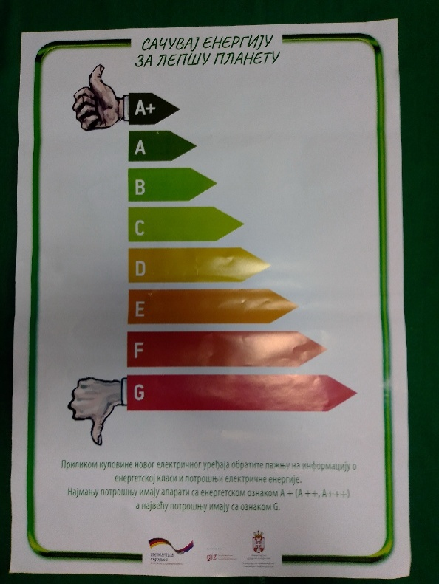
With the aim to raise our students’ awareness of energy efficiency, the team from Serbia organised the activity where the students competed through games in knowledge on this subject.
Students of the 6th grade (aged 12 ) took part in this activity.

Slide 4
The librarian and biology teacher held the presentation on energy efficiency for the students who were interested in the subject and then the teams for the competition were formed.

Slide 5
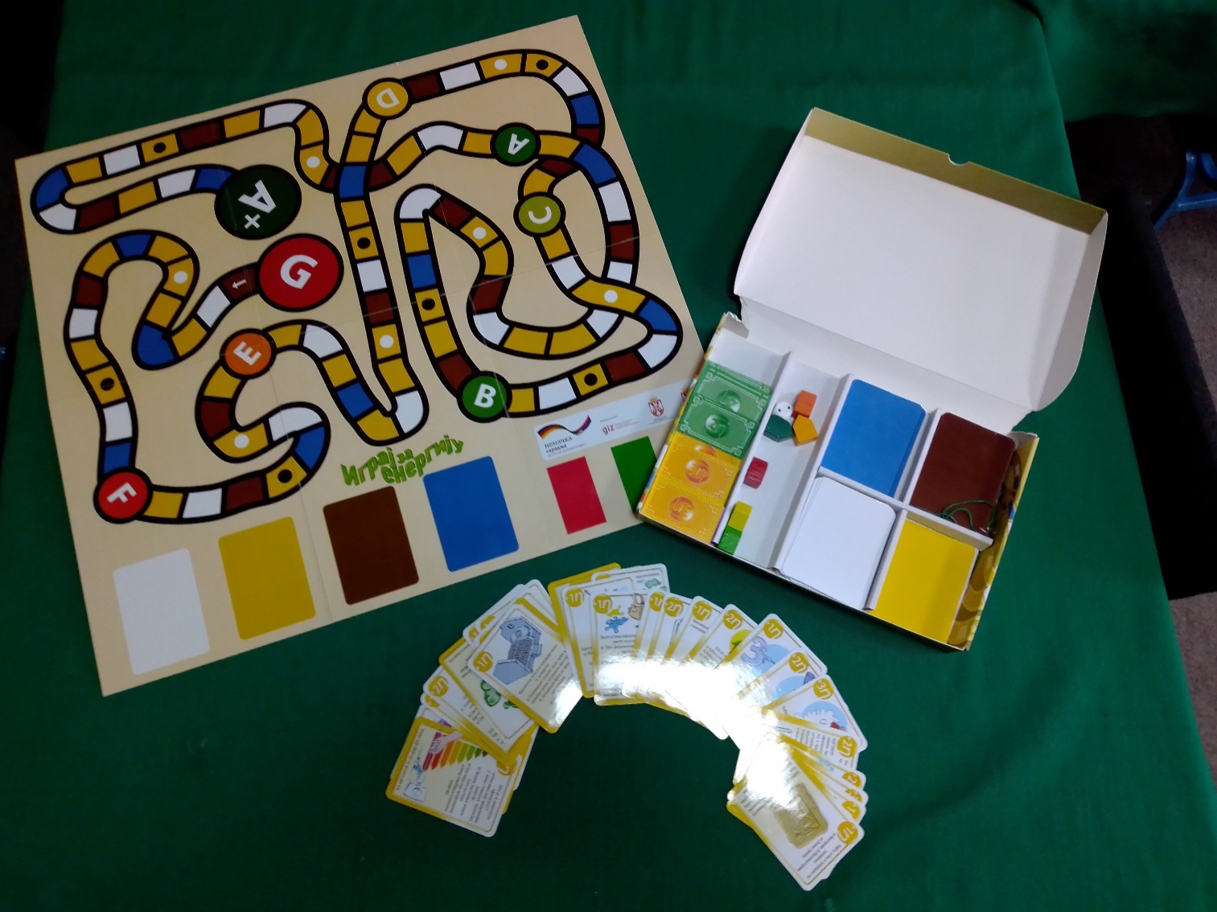
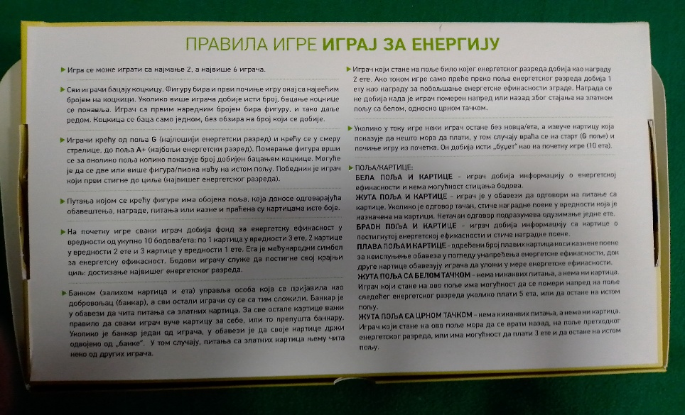
Each team had three contestants.
The competition was based on social game “Play for energy“ which has questions about energy efficiency.

Slide 6
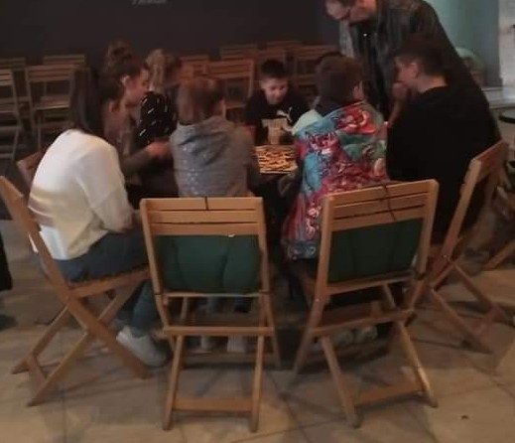
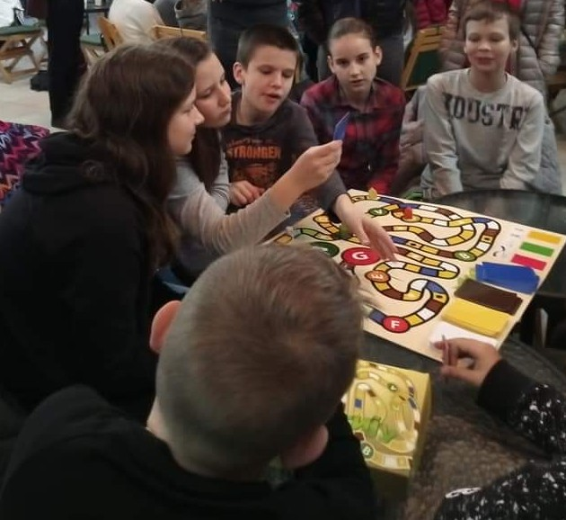
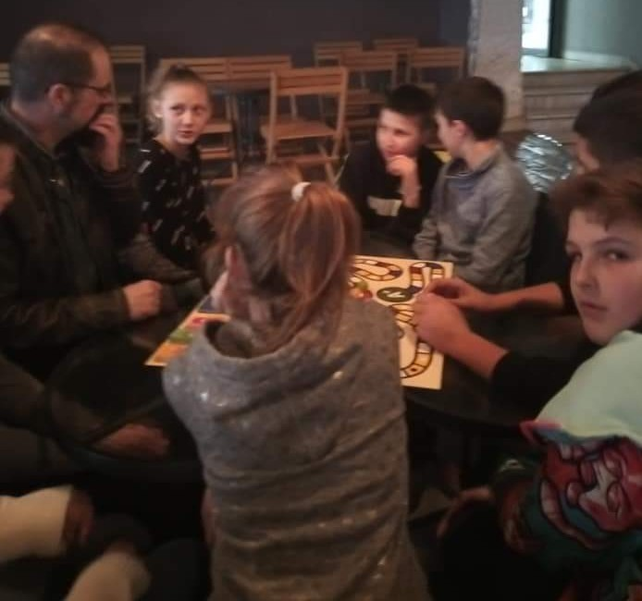
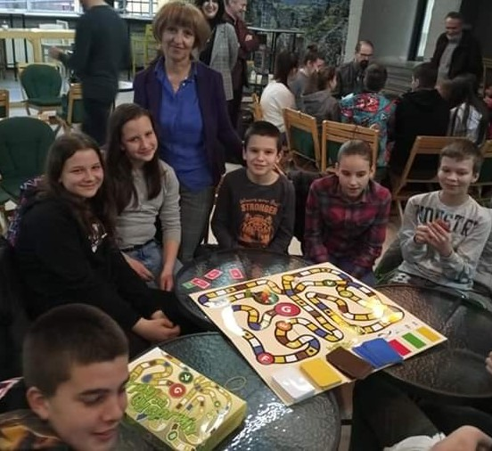
The competition was held on 5th March–Day of energy efficiency
There were eight teams.
In the first round the teams competed in pairs.
The winners from the first round( 4 teams ) competed in the second round.
The winners of the second round(2 teams) played in the third round- the final round and the winner was the team with the most knowledge and skills.

Slide 8
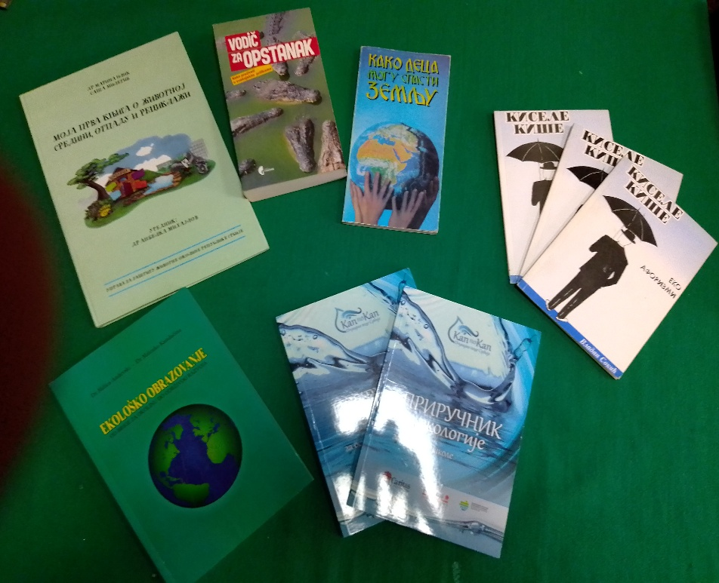
The winners won several nice books as a present.

